Slide 1

AL-FARABI KAZAKH NATIONAL UNIVERSITY
FACULTY OF MEDICINE AND HEALTHCARE
Analysis of variance
(ANOVA)
Saktapov Akylbek

Slide 2
Definition
The one-way analysis of variance (ANOVA) is used to determine whether there are any statistically significant differences between the means of three or more independent (unrelated) groups.
For example, you could use a one-way ANOVA to understand whether exam performance differed based on test anxiety levels amongst students, dividing students into three independent groups (e.g., low, medium and high-stressed students).
H0 = means are equal
H1 = means are unequal

Slide 3
When to use a one way ANOVA
Situation 1: You have a group of individuals randomly split into smaller groups and completing different tasks. For example, you might be studying the effects of tea on weight loss and form three groups: green tea, black tea, and no tea.
Situation 2: Similar to situation 1, but in this case the individuals are split into groups based on an attribute they possess. For example, you might be studying leg strength of people according to weight. You could split participants into weight categories (obese, overweight and normal) and measure their leg strength on a weight machine.

Slide 4
ASSUMPTIONS
Dependent variable should be measured at the interval or ratio level (i.e., they are continuous).
Example, measured in hours, IQ score, measured in kg.
Independent variable should consist of three or more categorical, independent groups.
Example, physical activity level (4 groups: sedentary, low, moderate and high), profession (3 groups: doctor, teacher, manager).
Have independence of observations, which means that there is no relationship between the observations in each group or between the groups themselves.
For example, there must be different participants in each group with no participant being in more than one group.
There should be no significant outliers.
Dependent variable should be approximately normally distributed for each category of the independent variable.
There needs to be homogeneity of variances. Levene's test for homogeneity of variances.

Slide 5
Calculation
Total Sum of Squares = Sum of Squares within Groups + Sum of Squares between Groups

Slide 6
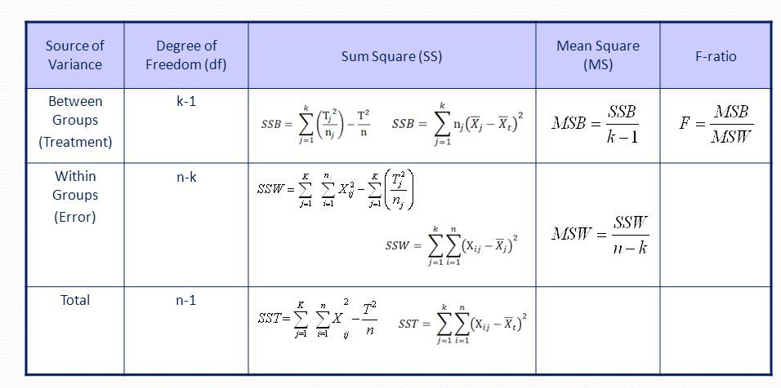
Calculation

Slide 7
Degrees of Freedom (df)
df between = k - 1
df within= N – k
Df (n;d)
k – number of groups
N – total sum of samples

Slide 8
F – Test Statistic
F = MSSb / MSSw
F – Test Statistic
MSSb - Mean Sum of Square Between Groups
MSSw - Mean Sum of Square Within Groups

Slide 9
Results
p value > 0,05 fail to reject H0
p value < 0,05 reject H0
1 type error = there’s no significance, you concluded that there’s
2 type error = there’s significance, you concluded that there’s not

Slide 10
Example
A pharmaceutical company conducts an experiment to test the effect of a new cholesterol medication. The company selects 15 subjects randomly from a larger population. Each subject is randomly assigned to one of three treatment groups. Within each treatment group, subjects receive a different dose of the new medication. In Group 1, subjects receive 0 mg/day; in Group 2, 50 mg/day; and in Group 3, 100 mg/day.
In conducting this experiment, the experimenter has two research questions:
Does dosage level have a statistically significant effect on cholesterol level?
How strong is the effect of dosage level on cholesterol level?

Slide 11
Thank you for your attention!!!

